Slide 1
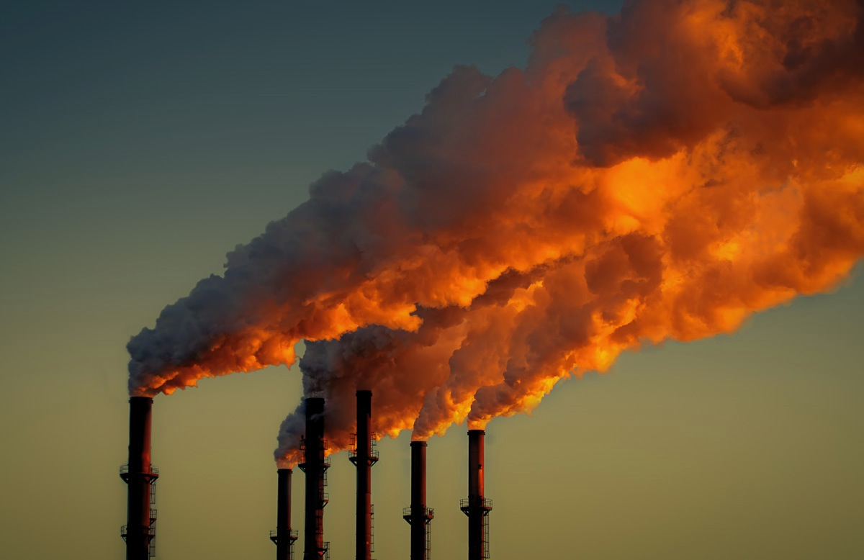
We know we have a problem…

Slide 2
Imagine

Slide 3
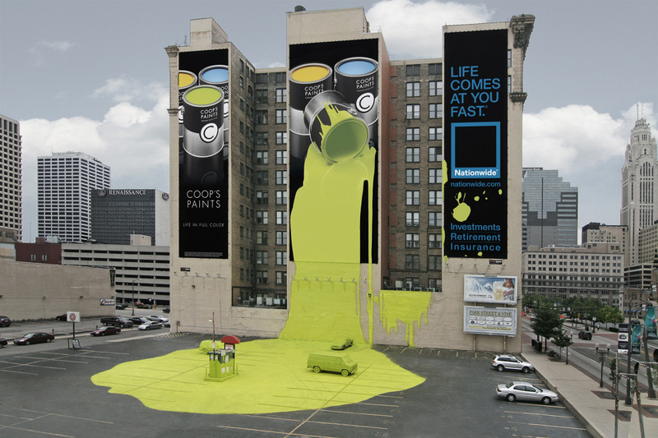
Inspires
Creativity

Slide 4
Promotes Collaboration

Slide 5
Sustains Health

Slide 6
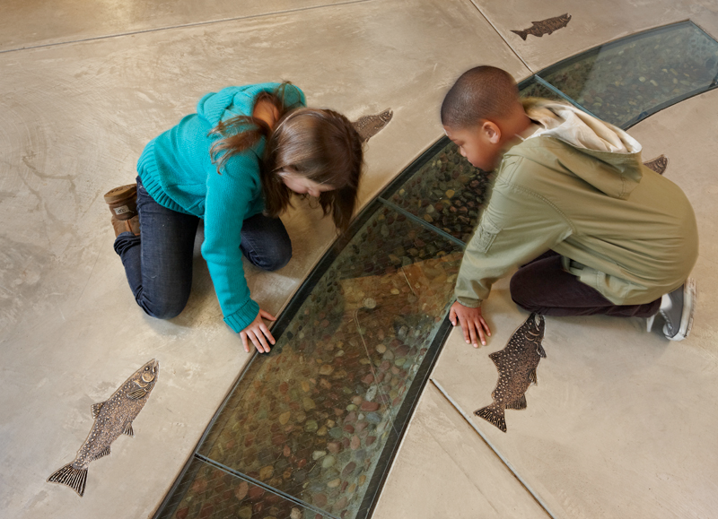
Inspires Learning

Slide 8
Positive Future

Slide 9
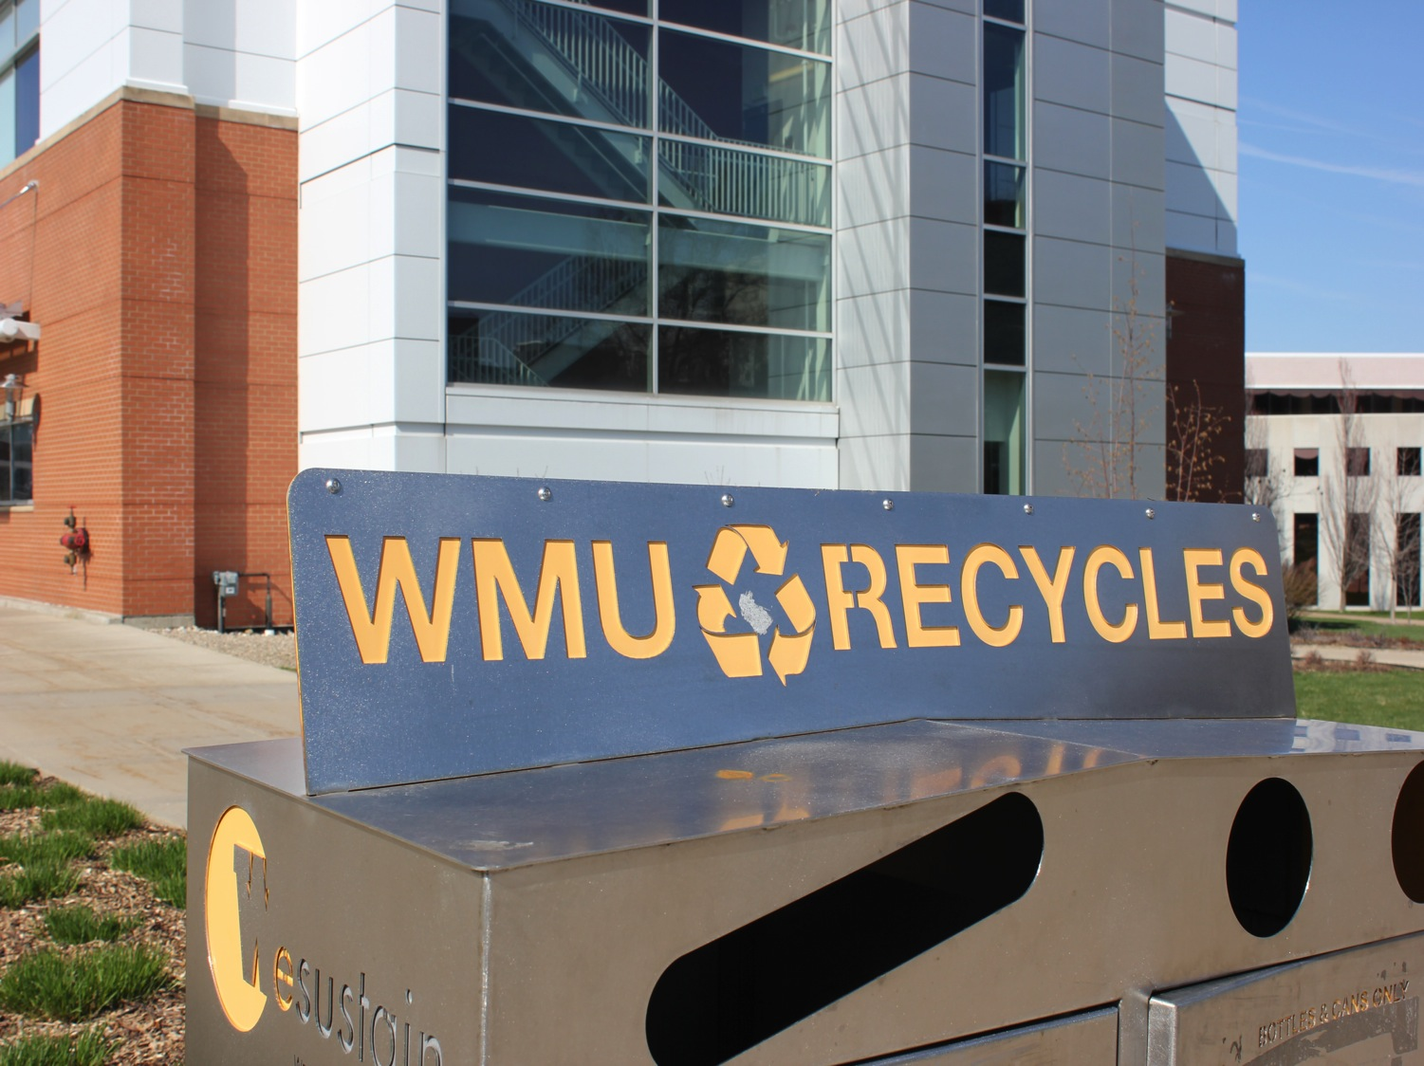
Endorses Responsibility

Slide 10
Reaches Net Zero

Slide 12
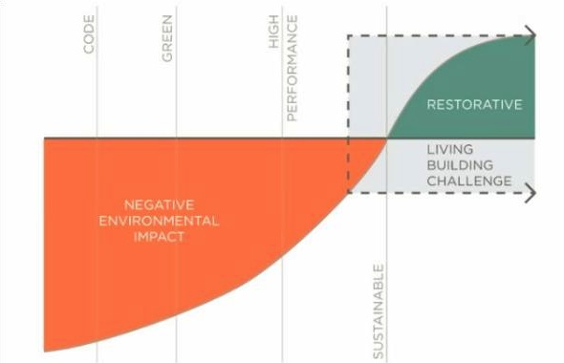

Slide 13
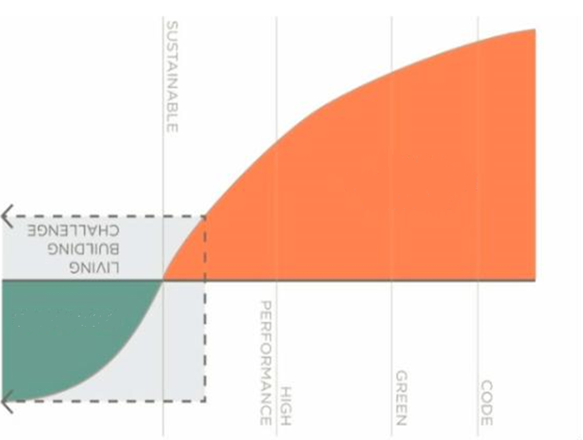
Costs
Savings

Slide 14
LIFE CYCLE COSTS

Slide 15
OUR GOAL
Western Michigan University

Slide 16
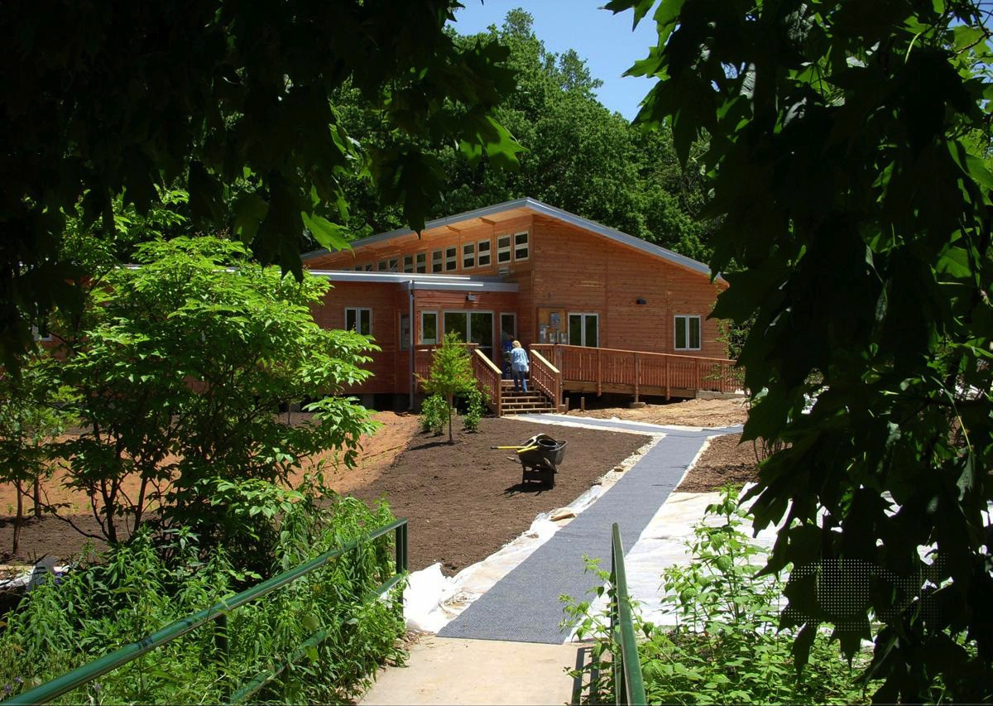
Tyson Research Center
Eureka, MO
Notes:
Here are a few examples of certified projects, and projects that are in their 12-month operational phase prior to audit, under construction or on-the-boards.
Case studies about certified projects can be found on the Institute’s website. The Institute also digitally publishes a quarterly handout called Taking Root that provides information about project’s in progress as well as an updated map of project locations.
(SCROLL THROUGH THESE PAGES AND CALL OUT PARTICULAR PROJECTS AS IT RELATES TO YOUR PRESENTATION OR LOCATION.)

Slide 17
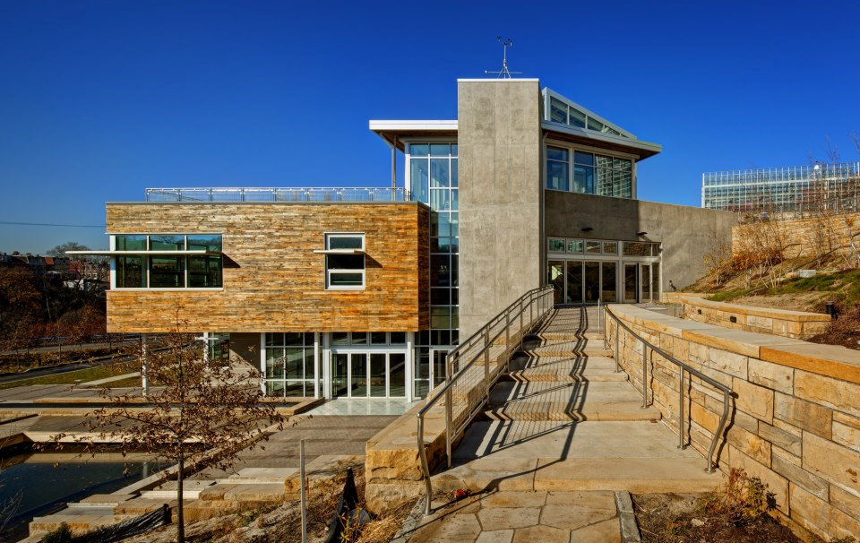
Phipps Center for Sustainable Landscapes
Pittsburgh, PA
Notes:
Here are a few examples of certified projects, and projects that are in their 12-month operational phase prior to audit, under construction or on-the-boards.
Case studies about certified projects can be found on the Institute’s website. The Institute also digitally publishes a quarterly handout called Taking Root that provides information about project’s in progress as well as an updated map of project locations.
(SCROLL THROUGH THESE PAGES AND CALL OUT PARTICULAR PROJECTS AS IT RELATES TO YOUR PRESENTATION OR LOCATION.)

Slide 18
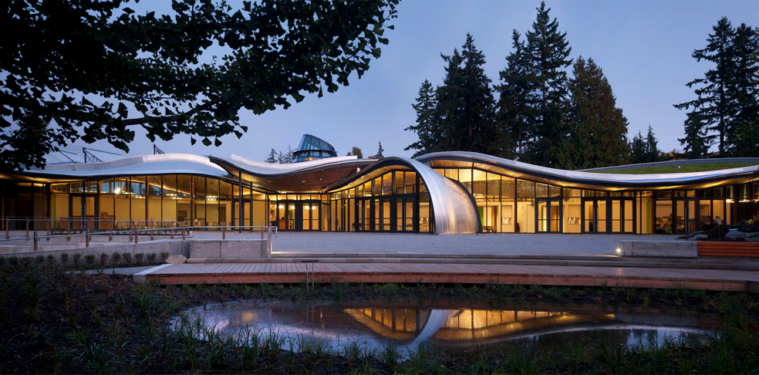
VanDusen Botanical Garden Visitor Centre
Vancouver, British Columbia
Notes:
Here are a few examples of certified projects, and projects that are in their 12-month operational phase prior to audit, under construction or on-the-boards.
Case studies about certified projects can be found on the Institute’s website. The Institute also digitally publishes a quarterly handout called Taking Root that provides information about project’s in progress as well as an updated map of project locations.
(SCROLL THROUGH THESE PAGES AND CALL OUT PARTICULAR PROJECTS AS IT RELATES TO YOUR PRESENTATION OR LOCATION.)

Slide 19
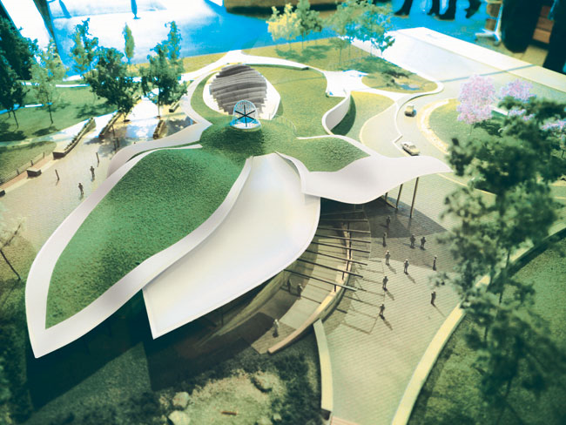
VanDusen Botanical Garden Visitor Centre
Vancouver, British Columbia
Notes:
Here are a few examples of certified projects, and projects that are in their 12-month operational phase prior to audit, under construction or on-the-boards.
Case studies about certified projects can be found on the Institute’s website. The Institute also digitally publishes a quarterly handout called Taking Root that provides information about project’s in progress as well as an updated map of project locations.
(SCROLL THROUGH THESE PAGES AND CALL OUT PARTICULAR PROJECTS AS IT RELATES TO YOUR PRESENTATION OR LOCATION.)

Slide 20
THE CHALLENGE
Water
Beauty
Equity
Health
Site
Energy
Materials

Slide 21
SITE

Slide 22
SITE

Slide 23
SITE

Slide 24
SITE

Slide 25
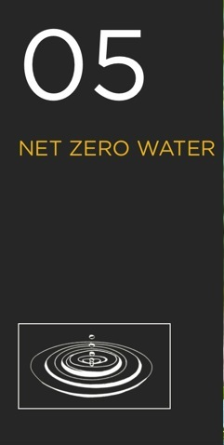
WATER

Slide 26
WATER

Slide 27
ENERGY

Slide 28
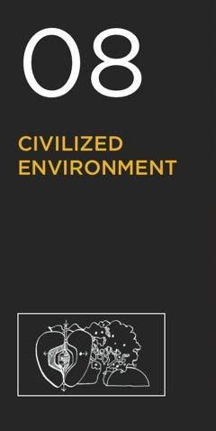
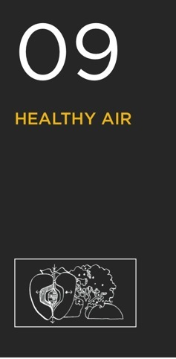
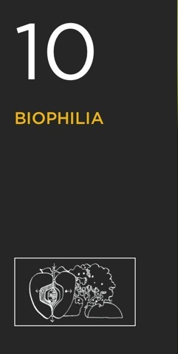
HEALTH

Slide 29
HEALTH

Slide 30
HEALTH

Slide 31
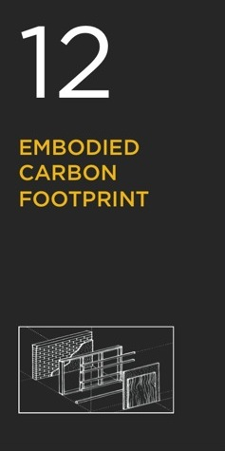
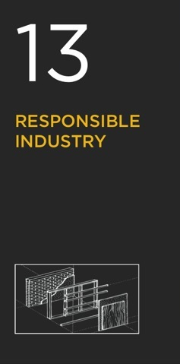
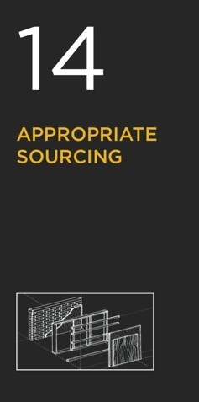
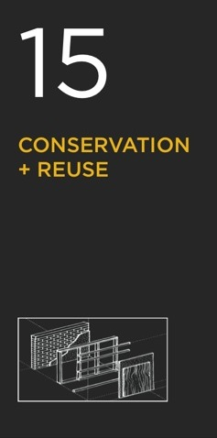
MATERIALS

Slide 32
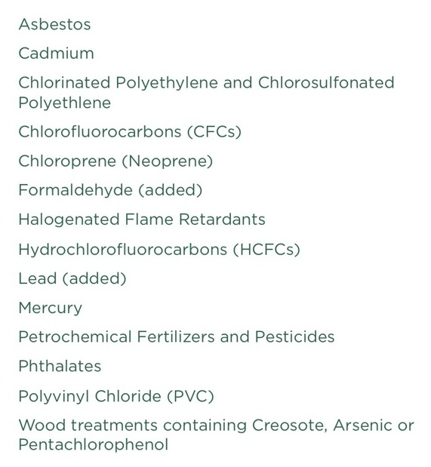
MATERIALS

Slide 33
MATERIALS

Slide 34
MATERIALS

Slide 35
MATERIALS

Slide 36
MATERIALS

Slide 37
MATERIALS

Slide 38
EQUITY

Slide 39
EQUITY

Slide 40
EQUITY

Slide 41
BEAUTY

Slide 42
BEAUTY

Slide 43
ALL
OR
NOTHING

Slide 44
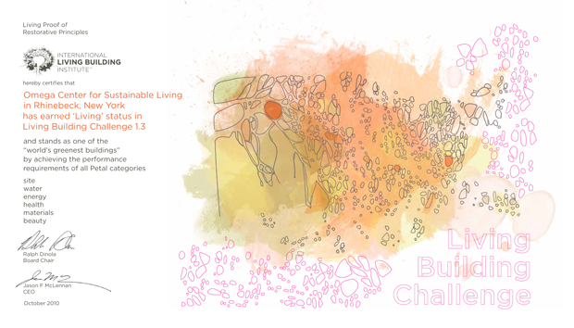
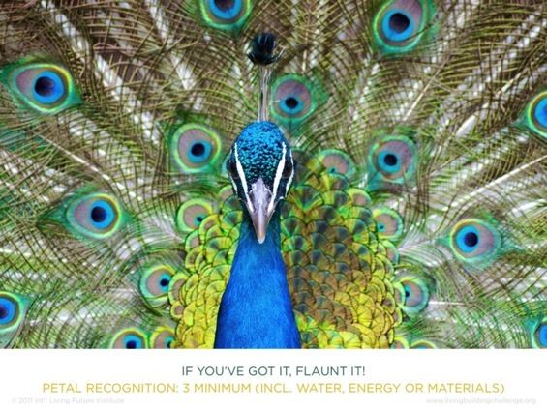
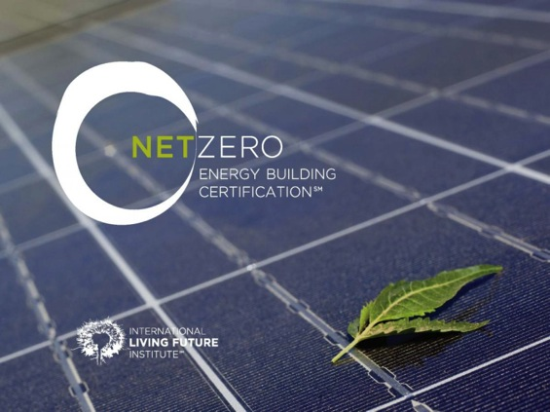
CERTIFICATIONS

Slide 45
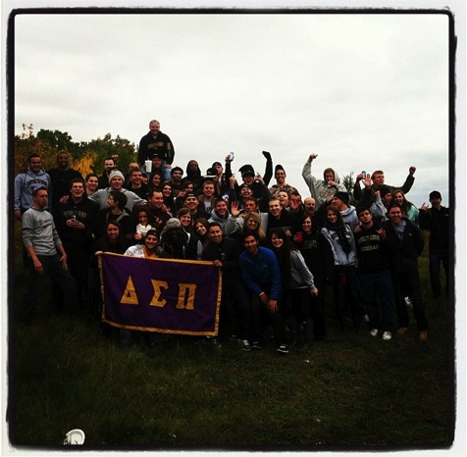
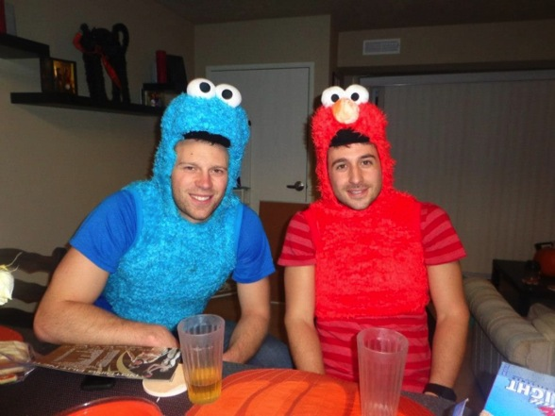
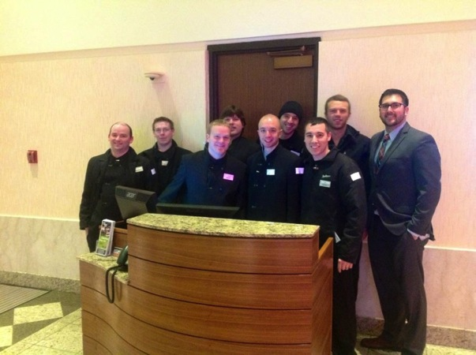
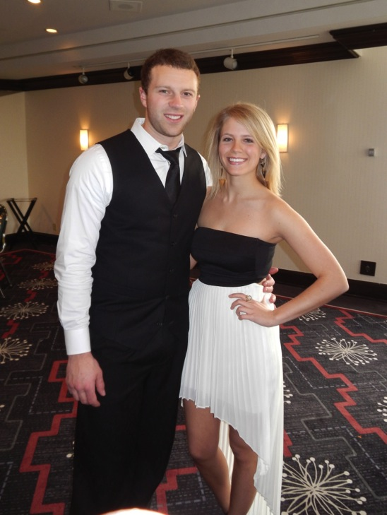
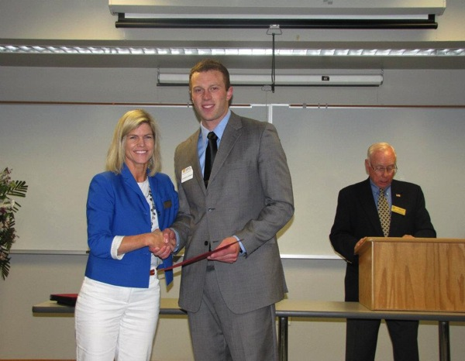
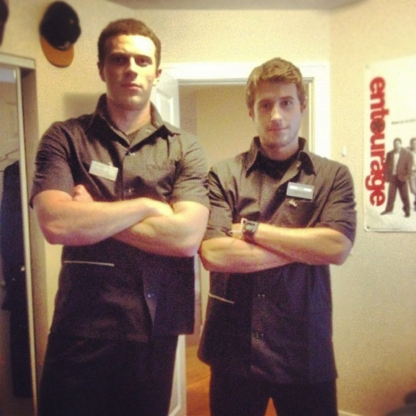
MY STORY
Notes:
What’s one more thing?

Slide 46
MY STORY
Environmental
Sales
Marketing
Know Nothing About Science
No
Connections
Market
To
Students

Slide 47
MARKETING
World
Community
Students

Slide 49
SOCIAL MEDIA

Slide 50
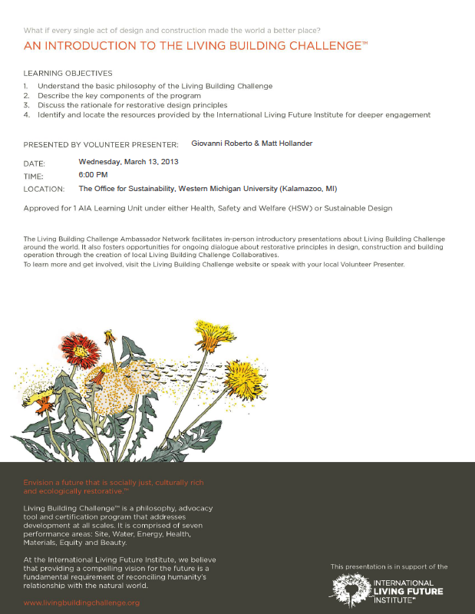
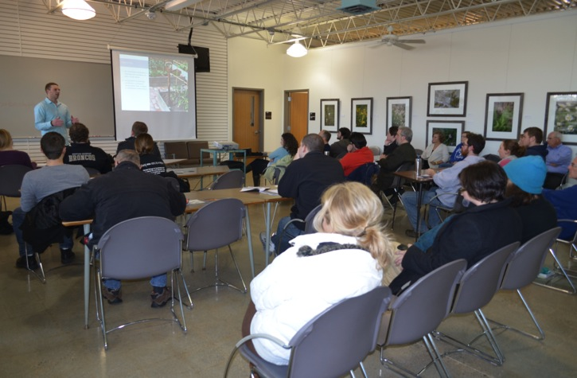
PRESENTATIONS
50+ People

Slide 51
RADIO
39 Online Broadcasts
246 People Reached
3,000+ People Tuned In

Slide 52
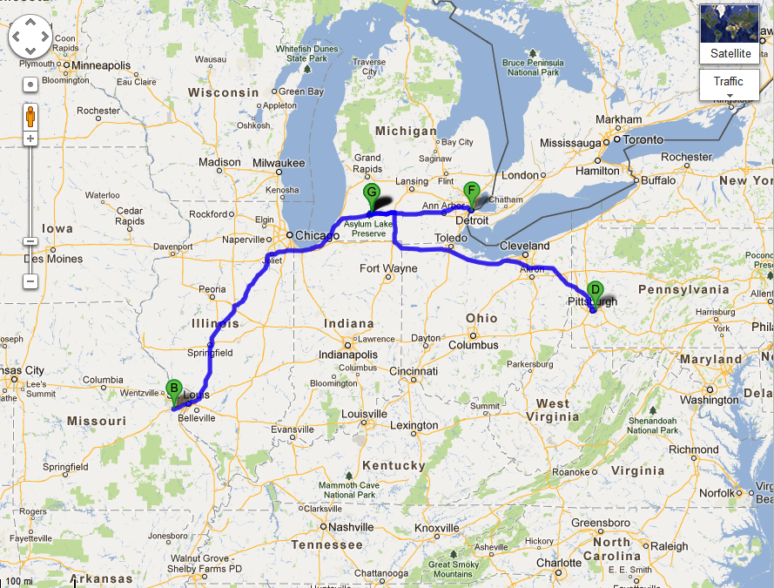
TRAVELS
Kalamazoo, MI
Detroit, MI
Pittsburgh, PA
Eureka, MO
2000+ Miles
30+ Hours

Slide 53
CHALLENGES
Producer
The Perfect Fit
Building a Team

Slide 54
CHALLENGES
Producer
The Perfect Fit
Building a Team

Slide 55
CHALLENGES
Producer
The Perfect Fit
Building a Team

Slide 56
CHALLENGES
Producer
The Perfect Fit
Building a Team

Slide 57
LEARNING

Slide 58
LEARNING
TIME MANAGEMENT

Slide 59
LEARNING
TIME MANAGEMENT
COLD CALLING

Slide 60
LEARNING
TIME MANAGEMENT
COMMUNICATION
COLD CALLING

Slide 61
LEARNING
SOCIAL MEDIA
TIME MANAGEMENT
COMMUNICATION
COLD CALLING

Slide 62
LEARNING
SOCIAL MEDIA
TIME MANAGEMENT
ENVIRONMENTAL ISSUES & JARGON
COMMUNICATION
COLD CALLING

Slide 63
LEARNING
SOCIAL MEDIA
TIME MANAGEMENT
FILM PRODUCTION
ENVIRONMENTAL ISSUES & JARGON
COMMUNICATION
COLD CALLING

Slide 64
LEARNING
SOCIAL MEDIA
TIME MANAGEMENT
PASSION
FILM PRODUCTION
ENVIRONMENTAL ISSUES & JARGON
COMMUNICATION
COLD CALLING

Slide 65
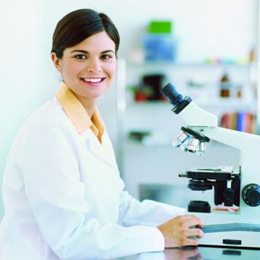
WHY WMU?
STUDENTS
DISCOVERIES

Slide 66
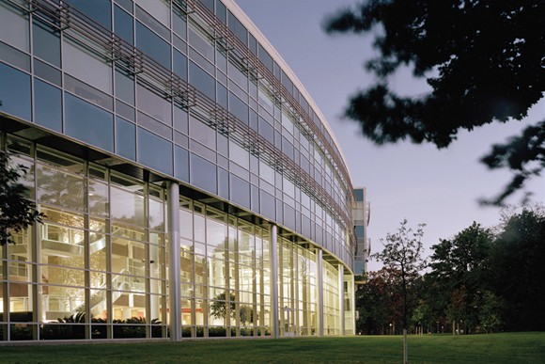
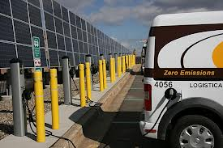
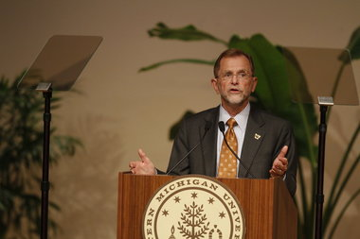
WHY WMU?
Natural Light Heat Exchange System
Solar Panels
Net Zero Storm Water
Presidents' Climate Commitment (ACUPCC)

Slide 67
WMU MISSION
Western Michigan University is a learner-centered, research university, building intellectual inquiry and discovery into undergraduate, graduate, and professional programs in a way that fosters knowledge and innovation, and transforms wisdom into action. As a public university, WMU provides leadership in teaching, research, learning, and service, and is committed to enhancing the future of our global citizenry.

Slide 68
WMU MISSION
Western Michigan University is a learner-centered, research university, building intellectual inquiry and discovery into undergraduate, graduate, and professional programs in a way that fosters knowledge and innovation, and transforms wisdom into action. As a public university, WMU provides leadership in teaching, research, learning, and service, and is committed to enhancing the future of our global citizenry.

Slide 69
WMU MISSION
Western Michigan University is a learner-centered, research university, building intellectual inquiry and discovery into undergraduate, graduate, and professional programs in a way that fosters knowledge and innovation, and transforms wisdom into action. As a public university, WMU provides leadership in teaching, research, learning, and service, and is committed to enhancing the future of our global citizenry.

Slide 71
If we have the ability to make the world a better place…
Why not do it?

